Slide 1
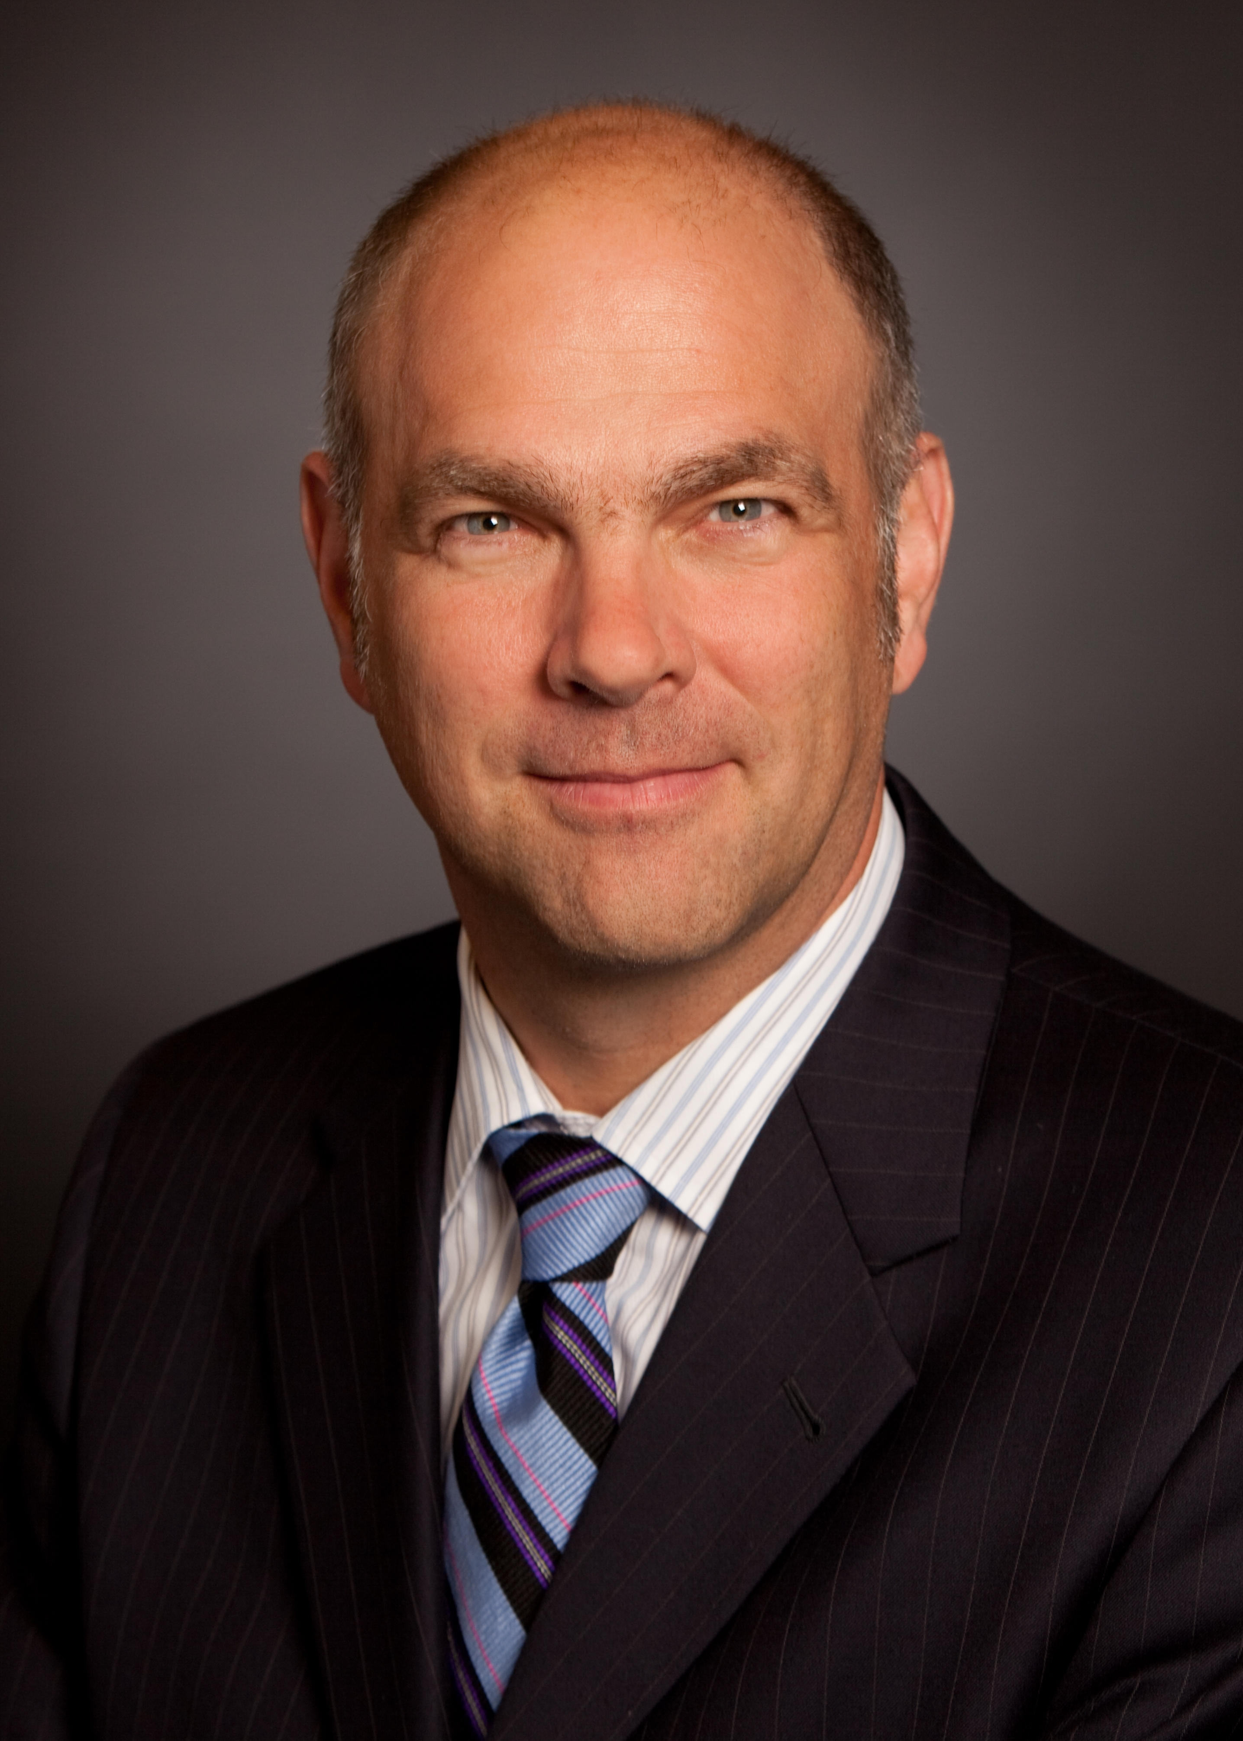
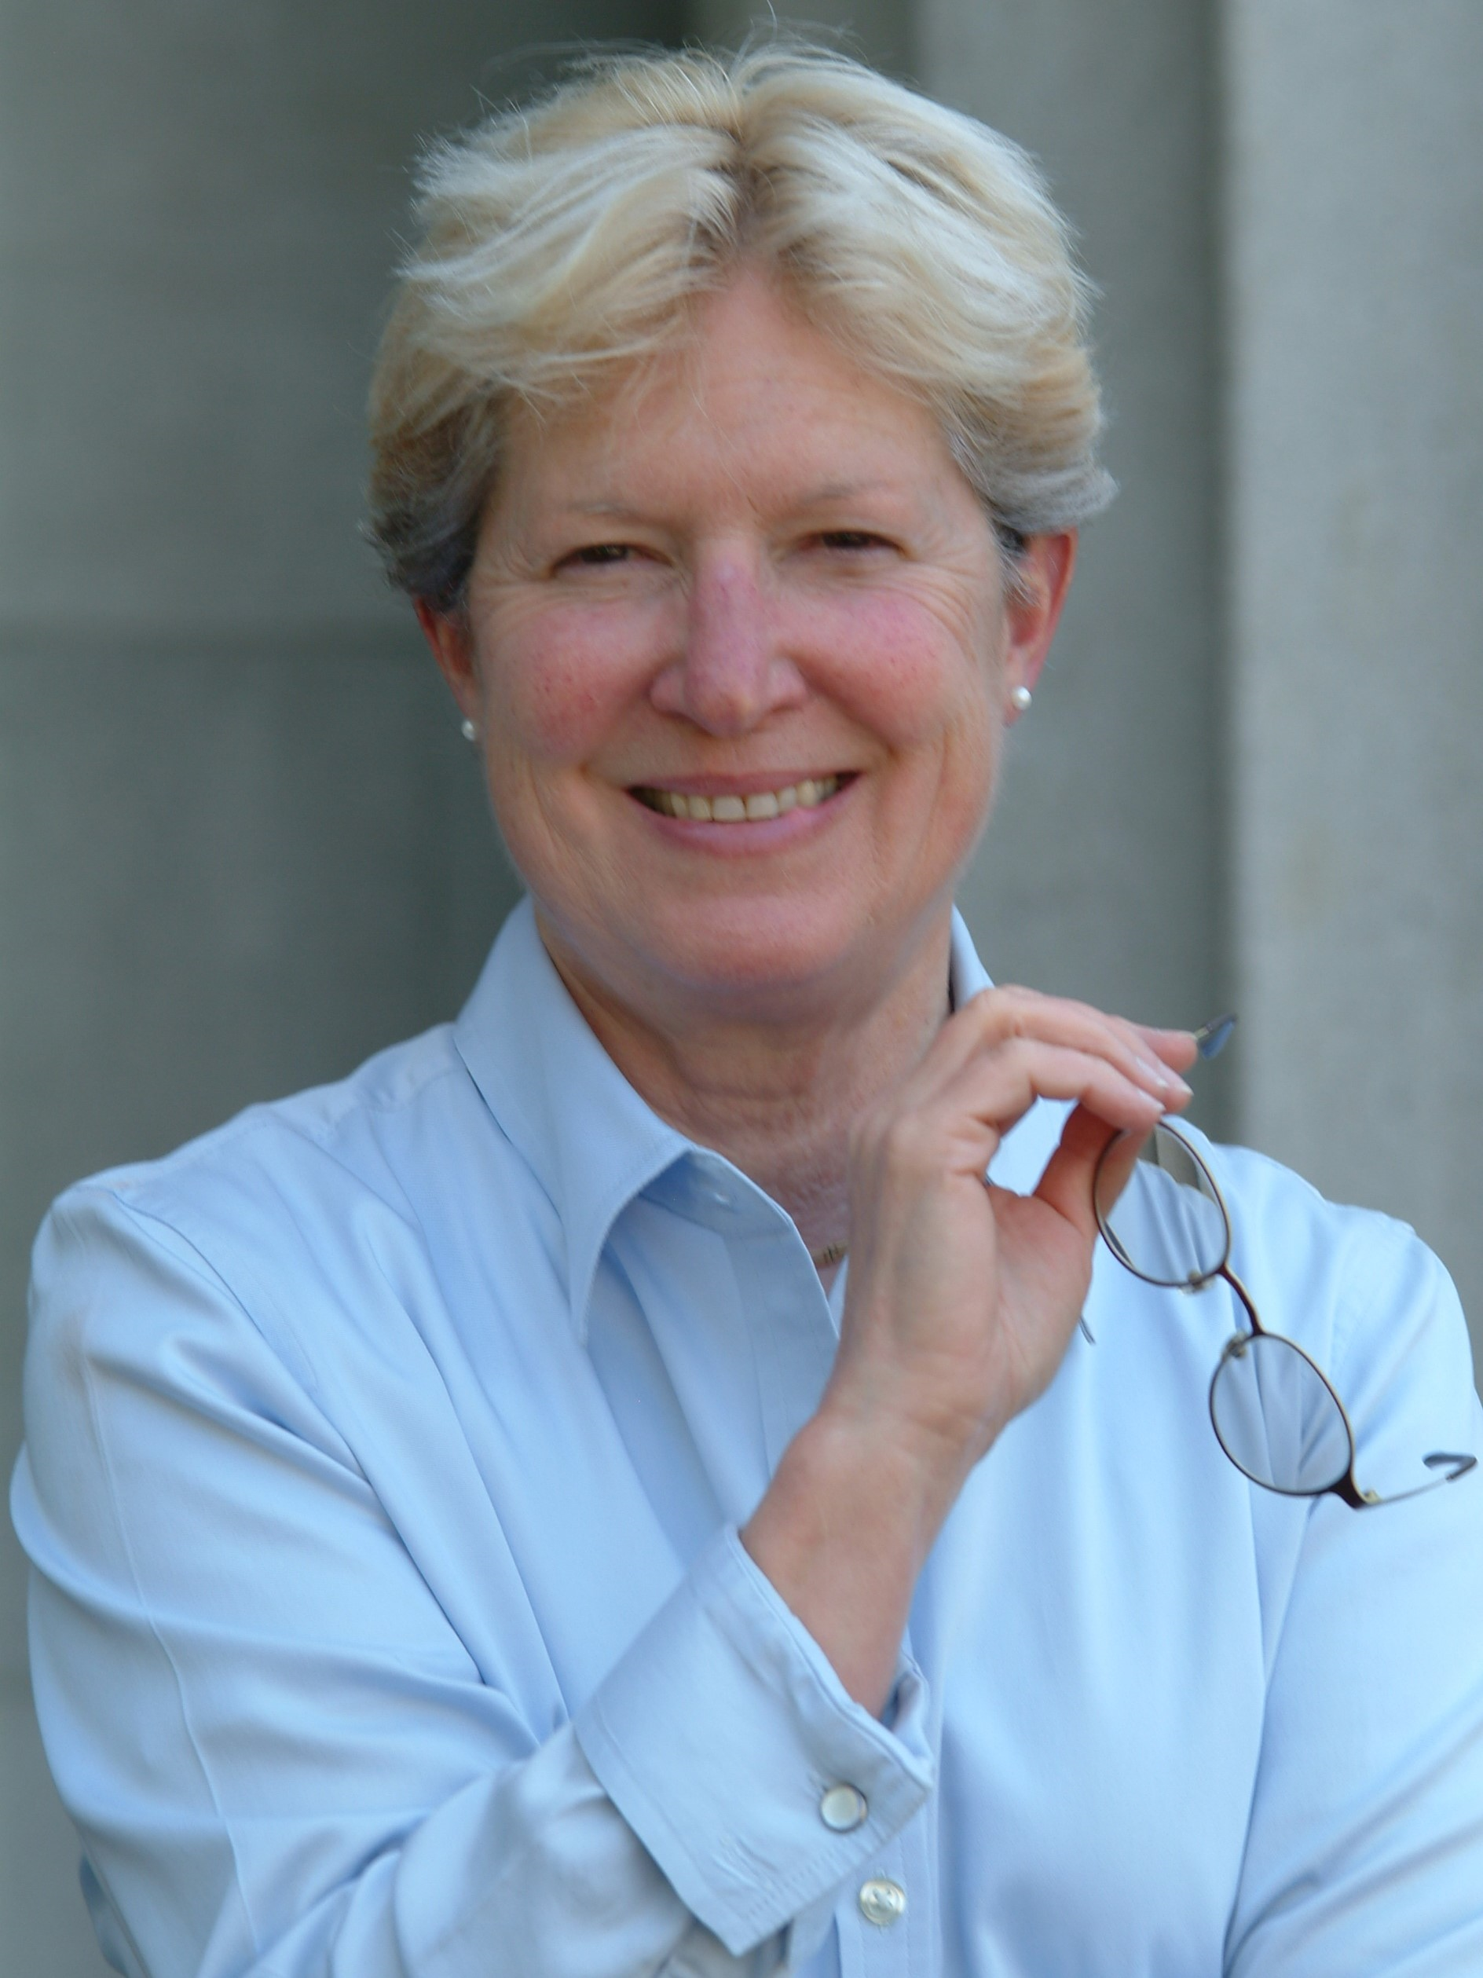
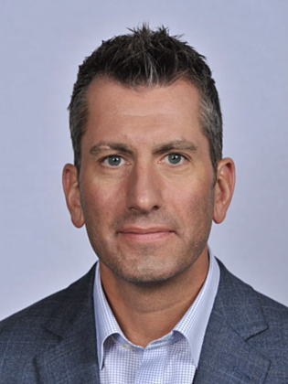
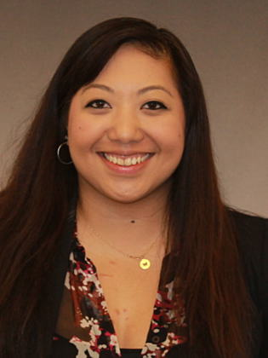
Americas Distribution Work with Us. Win with Us.
Andrew Sage
Vice President
Sandra Higby-Chandler
Exec Assistant
Ashley Black
Executive Communications
Craig Cieplinski
Director, Partner Ops
Ingram, Comstor,
ScanSource
Michael Perez
Director, Partners Ops
Tech Data/
D&H/TelcoBuy
Ryan Kingston
Manager
Distribution
Services/Software
Renato Crepaldi
Manager
Latam Disti
Vanessa Chet
Sr. Manager
Sales/ResellerBusiness Dev Strategy & Planning
Carla Cicero
MPO-Ingram
Mike O’Connell
MPO-Comstor
Vanessa Beauparlant
DAM-Tech Data
Eric Cieplinski
Disti Services/SW Mgr
Kim Christensen
Regional DAM
Jim Parker
DAM-ScanSource
Steven Foster
Mgr. Distribution Programs
Scott Parrillo
DAM-ScanSource
Steve Guillman DAM-Tech Data
Patrick Dempsey
Disti Services/SW Mgr
Obed Garcia
Regional DAM
Tara Boffa
Program Manager
Pat Kearney
DAM-Ingram
Pippa Sturkey
DAM-Comstor
Mariana Andriolo
DAM-Brazil
Marc Jacobs
SE-ScanSource/D&H
Troy Helsen
DAM-Tech Data
Don Harrington
Disti Services/SW Mgr
Heather Chynoweth
Analyst
Kristeen Webb
DAM-Ingram
Josh Rennick
DAM-Comstor
Yadhira Zamudio
DAM-Mexico
Ryan Taggatz
DAM-Tech Data
Mark Dobbie
Business Ops Mgr
Michelle Meller McCrea
DAM-Ingram
Kinney Yee
SE-Comstor
Gabby McGee
Disti Services/SW Mgr
Greg Cooney
SE-Tech Data
Karina Benitez
Program Analyst Argentina
Kimberly Nancarrow
Virtual Sales V-PAM
Jeff Barnhart
SE-Ingram
Jeff McEachern BDM/Software
Olivia Messina
Analyst
Dave Nentarz
SE-Tech Data
Ivan Sanfilippo
DAM-Telcobuy
Tasha Mundy
Disti/Services/SW Mgr
Nicholas Stavropoulos
Analyst
Amy Tutich
DAM-D&H
TBD
SBDM-Collaboration
Brenda Morris
Program Manager
Rob Keeler
SBDM-DC/V
Scott Schweizer
SBDM-Security
Amy Hodge
SBDM-Enterprise Networking
Published Q4 FY18
Cisco Employee
Contractor

Slide 2
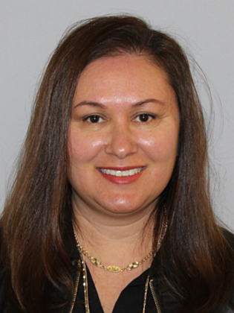
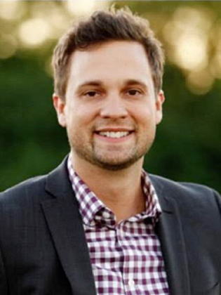
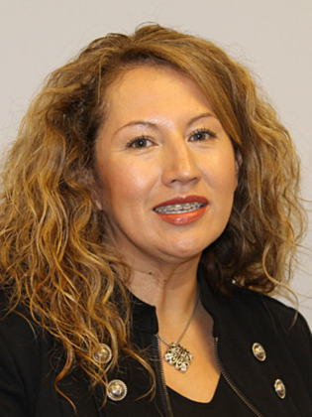
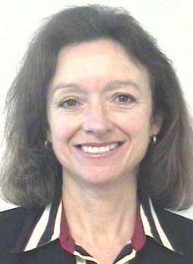
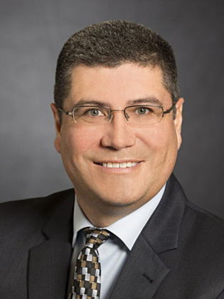
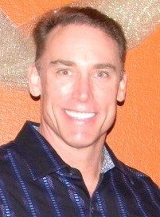
Americas Distribution FY18 Extended Team
Tracey Hutchison
Manager, Canada
2Tier, Disti, NDI
Partner Sales
Sally Corely
Customer
Service
Stephen Tessitore
Distribution
Marketing
Laura Dominguez
HR
Laura Dominguez
HR
Charles Sommerhauser
Public Relations
Marcio Andrade
Controller
Cynthia Sanduski
Legal
Sam Valdez
Supply Chain
Extended Team

